Slide 1

Access Control
Building Access Control

Slide 2
INTRODUCTION
Today, cybersecurity is a growing concern to not only government agencies, but to business as well. Everyone used to manage access to campuses, offices, and laboratories through the use of key and guards. Access was managed by the issuing of keys.
While the options of guards and keys are still relevant to day, a better security solution reduces the human factor in physical security. Keys get lost, locks have to be changed, then there’s the unpredictable human factor to take into account.

Slide 3
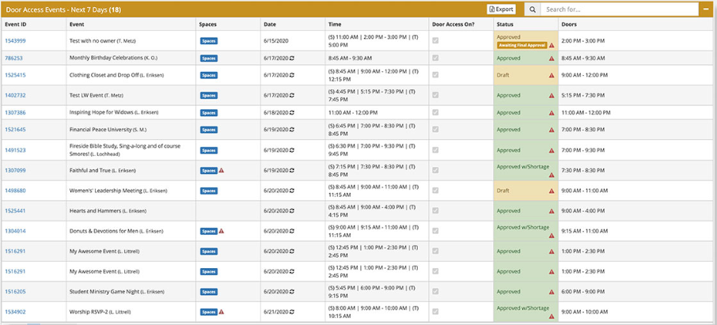
Smart Church Solutions has also designed a door access application that logs events such as the opening of doors and whether access was accepted or denied.

Slide 4
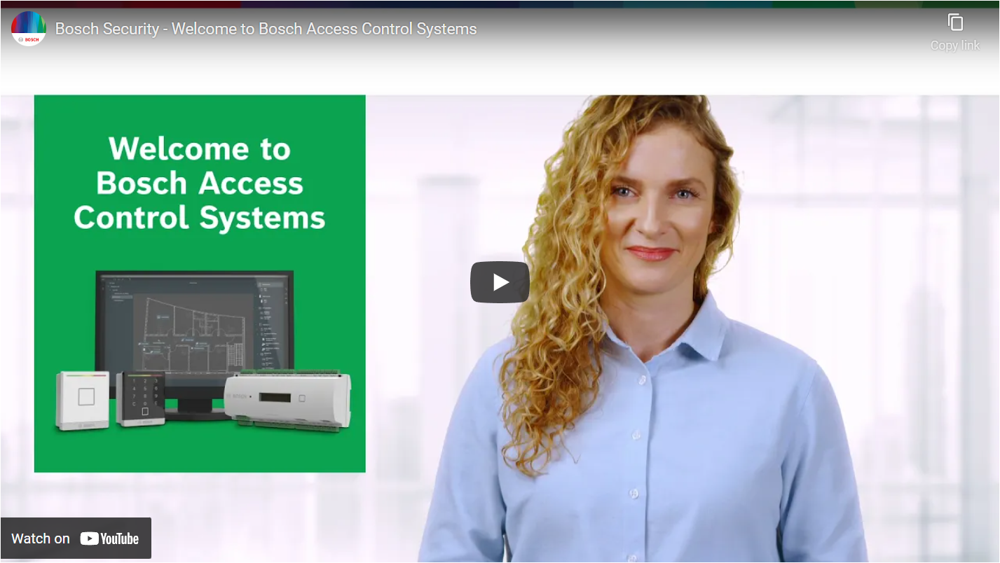
Bosch has a software suite that can scale up as needed. You can integrate video camera feeds, guard tours, and access controls to your system.

